Slide 1
Gradient Descent

Slide 2
Outline
A
B

Slide 3
Gradient Descent
a

Slide 4
In Machine Learning,
we optimize a lot of stuff

Slide 5


In Linear Regression, we optimize the Intercept and Slope to find the best fitting line.
Height
$$y=m×x+b$$
$$Height=slope×weight+intercept$$
Weight

Slide 6
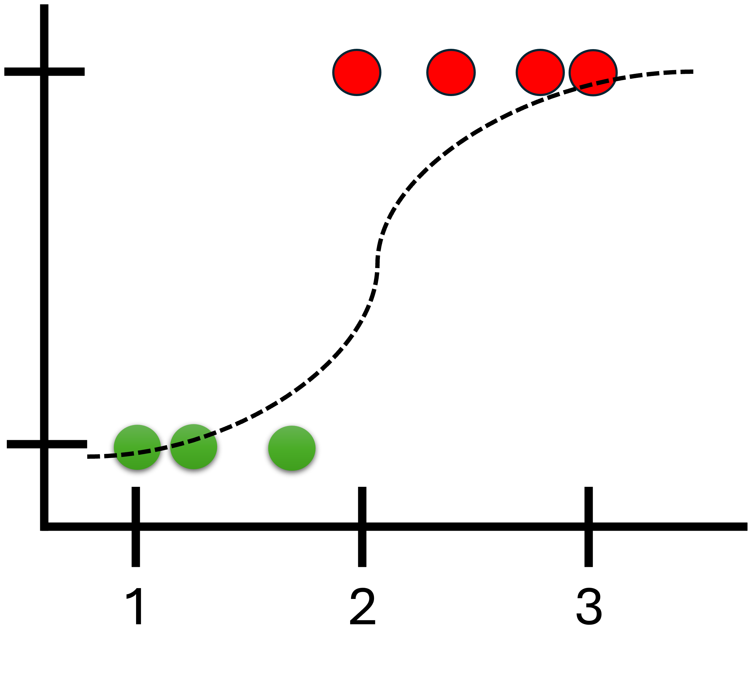
Linear Regression is just one example, there are a lot more machine learning models that we optimize such as..
Logistic Regression
Neural Network

Slide 7
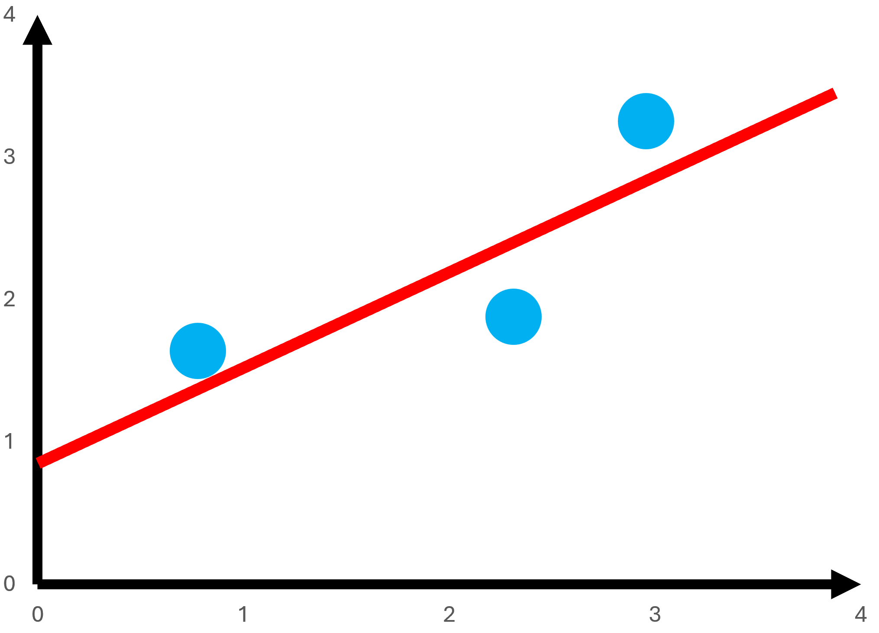
The good news is that Gradient Descent can optimize all of these models.
Linear Regression
Logistic Regression
Neural Network

Slide 8
So if we learn how to optimize a line in Linear Regression using Gradient Descent
Linear Regression
Logistic Regression
Neural Network

Slide 9
Then we can apply the same strategy to optimize a Logistic Regression model and a Neural Network
Linear Regression
Logistic Regression
Neural Network

Slide 10
And many more optimization problems we have in Machine Learning!
Linear Regression
Logistic Regression
Neural Network

Slide 11
Let us start with a simple data set of three persons.

Slide 12
On the x-axis, we have the person’s weight.
On the y-axis we have the person’s height
Height
Weight

Slide 13
If we fit a random line to the data.
Height
Weight

Slide 14

And someone tells us that they weigh 2
Height
Weight

Slide 15
We can use the random line to predict that they will have a height of 2.1
Height
Weight

Slide 16

Instead of fitting a random line, let us learn how Gradient Descent can fit a line to data by finding the optimal values for the Intercept and Slope.
Height
$$Height=slope×weight+intercept$$
Weight

Slide 17

We will start by using Gradient Descent to find the just the Intercept
Height
$$Height=slope×weight+intercept$$
Weight

Slide 18

Once we understand how Gradient Descent works, we will use it to find the Intercept and the Slope
Height
$$Height=slope×weight+intercept$$
Weight

Slide 19

So for now, let us plug in 0.64 for the slope
Height
$$Height=0.64×weight+intercept$$
Weight

Slide 20

Then we will use Gradient Descent to find the optimal value for the intercept.
Height
$$Height=0.64×weight+intercept$$
Weight

Slide 21

The first thing we do is to pick a random value for the intercept.
This is just an initial guess that gives Gradient Descent something to improve upon
Height
$$Height=0.64×weight+intercept$$
Weight

Slide 22

In this case, we will put 0 but any number will do.
Height
$$Height=0.64×weight+0$$
Weight

Slide 23
And that gives us the equation for this line
Height
$$Height=0.64×weight+0$$
Weight

Slide 24
Next, we will evaluate how well this line fits our data using Sum of Squared Error (SSE)
Height
Weight

Slide 25
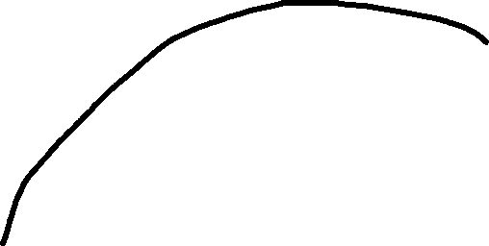
Let us calculate the residual or error for this datapoint
Height
Weight

Slide 26

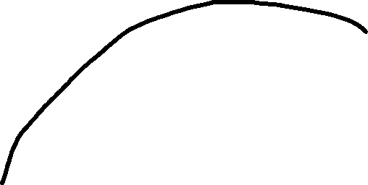

For this datapoint, it’s observed weight is 0.5 and observed height is 1.4
$$Height=0.64×0.5+0$$
Height
Thus, giving us a predicted height of 0.32
$$predicted Height=0.32$$
Weight

Slide 27




The error or residual would then be…
$$observed Height=1.4$$
Height
$$predicted Height=0.32$$
$$Error=observed height−predicted height$$
$$Error=1.4−0.32$$
Weight
$$Error=1.1$$

Slide 28
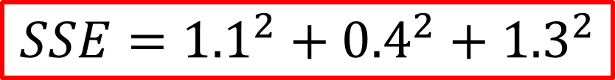
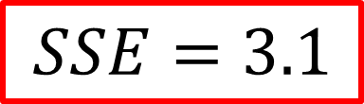
If we get the residual/error of all data points, it would be…
$$SSE={1.1}^{2}+{0.4}^{2}+{1.3}^{2}$$
Height
$$SSE=3.1$$
Weight

Slide 29
Now, let us plot the SSE to keep track of its value whenever we change the value of the intercept
Height
SSE
Weight
Intercept

Slide 30
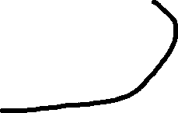
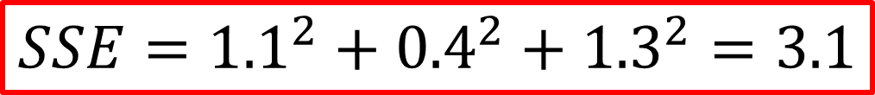
$$SSE={1.1}^{2}+{0.4}^{2}+{1.3}^{2}=3.1$$
This point represents the SSE when the intercept is 0
Height
SSE
Weight
Intercept

Slide 31
When we change the intercept to 0.25, the SSE decreases
Height
SSE
Weight
Intercept

Slide 32
And If we change the intercept to 0.5, the SSE decreases again
Height
SSE
Weight
Intercept

Slide 33
And we change the intercept to 0.9, the SSE decreases again
Height
SSE
Weight
Intercept

Slide 34
And as the value increase for the intercept, we get these points
Height
SSE
Weight
Intercept

Slide 35
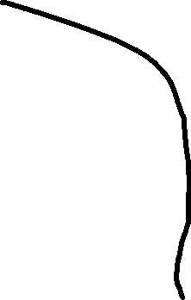
Of all the intercepts we used, our graph showed that this one has the lowest SSE
SSE
Intercept

Slide 36
Finding the lowest possible SSE by plugging in a bunch of values for intercept is a slow and painful method ☹
SSE
Intercept

Slide 37
This is where Gradient Descent comes to the rescue ☺
SSE
Intercept

Slide 38
Gradient Descent only performs a few calculations if it knows that it is far from the optimal solution
SSE
Intercept

Slide 39
And increases the number of calculations when it is closer to the optimal value
SSE
Intercept

Slide 40
In other words, Gradient Descent identifies the optimal value by taking big steps when it is far away from it.
SSE
Intercept

Slide 41
In other words, Gradient Descent identifies the optimal value by taking big steps when it is far away from it.
SSE
Intercept

Slide 42
In other words, Gradient Descent identifies the optimal value by taking big steps when it is far away from it.
SSE
Intercept

Slide 43
In other words, Gradient Descent identifies the optimal value by taking big steps when it is far away from it.
SSE
Intercept

Slide 44
And small steps when it is close to the optimal value
SSE
Intercept

Slide 45
And small steps when it is close to the optimal value
SSE
Intercept

Slide 46
And small steps when it is close to the optimal value
SSE
Intercept

Slide 47
So let us get back to using Gradient Descent to find the optimal value for the intercept, starting from a random value. In this case, intercept is zero
Height
SSE
Weight
Intercept

Slide 48

$$SSE{=(observed height−predicted height)}^{2}$$
When we calculated SSE, the first residual was the difference between the observed height which was 1.4 and the predicted height which came from the equation of this line
Height
$$predicted height=0.64×weight+intercept$$
Since this person weighed 0.5, the equation will be..
Weight
$$predicted height=0.64×0.5+intercept$$

Slide 49


$$SSE{=(observed height−predicted height)}^{2}$$
Plugging in the observed height and the predicted height for the first person we get..
Height
$$observed height=1.4$$
$$predicted height=0.64×0.5+intercept$$
$$SSE{=(1.4−(0.64×0.5+intercept))}^{2}$$
Weight

Slide 50
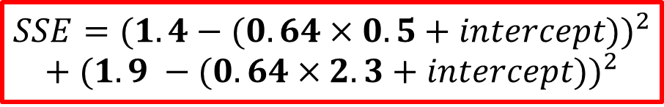


$$SSE{=(observed height−predicted height)}^{2}$$
Just like before, if we calculate the residual for the second person we get…
$$observed height=1.9$$
Height
Since this person weighed 2.3, the equation will be..
$$predicted height=0.64×2.3+intercept$$
Our SSE will now then be…
Weight
$$SSE{=(1.4−(0.64×0.5+intercept))}^{2}$$
$$+ {(1.9 −(0.64×2.3+intercept))}^{2}$$

Slide 51
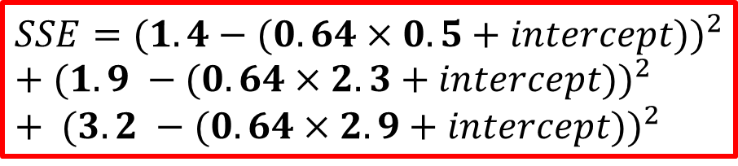


$$SSE{=(observed height−predicted height)}^{2}$$
For the third person if the observed height is…
$$observed height=3.2$$
Height
And since this person weighed 2.9, the equation will be..
$$predicted height=0.64×2.9+intercept$$
Our final SSE will now the be…
Weight
$$SSE{=(1.4−(0.64×0.5+intercept))}^{2}$$
$+ {(1.9 −(0.64×2.3+intercept))}^{2}$ $+ {(3.2 −(0.64×2.9+intercept))}^{2}$

Slide 52
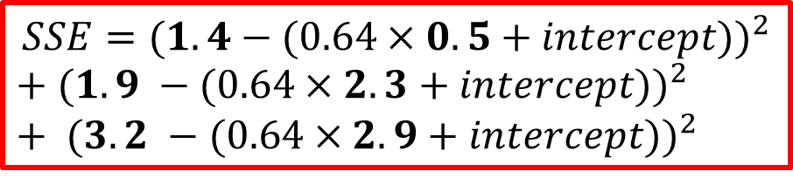
$$SSE{=(1.4−(0.64×0.5+intercept))}^{2}$$
$+ {(1.9 −(0.64×2.3+intercept))}^{2}$ $+ {(3.2 −(0.64×2.9+intercept))}^{2}$
Now we can easily plug in any value for the intercept and we also now have the equation for this curve
SSE
Intercept

Slide 53
$$SSE{=(1.4−(0.64×0.5+intercept))}^{2}$$
$+ {(1.9 −(0.64×2.3+intercept))}^{2}$ $+ {(3.2 −(0.64×2.9+intercept))}^{2}$
We can also take the derivative of this function and find the slope at any value for the intercept
SSE
Intercept

Slide 54
$$SSE{=(1.4−(0.64×0.5+intercept))}^{2}$$
$+ {(1.9 −(0.64×2.3+intercept))}^{2}$ $+ {(3.2 −(0.64×2.9+intercept))}^{2}$
We can also take the derivative of this function and find the slope at any value for the intercept
SSE
Intercept

Slide 55
$$SSE{=(1.4−(0.64×0.5+intercept))}^{2}$$
$+ {(1.9 −(0.64×2.3+intercept))}^{2}$ $+ {(3.2 −(0.64×2.9+intercept))}^{2}$
We can also take the derivative of this function and find the slope at any value for the intercept
SSE
Intercept

Slide 56
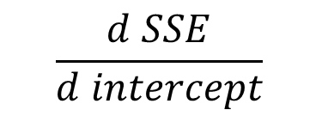
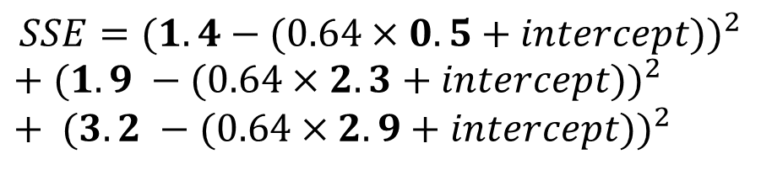
The next step is to take the derivate of the SSE with respect to the intercept
$$SSE{=(1.4−(0.64×0.5+intercept))}^{2}$$
$+ {(1.9 −(0.64×2.3+intercept))}^{2}$ $+ {(3.2 −(0.64×2.9+intercept))}^{2}$
$$\frac{d SSE}{d intercept}$$

Slide 57
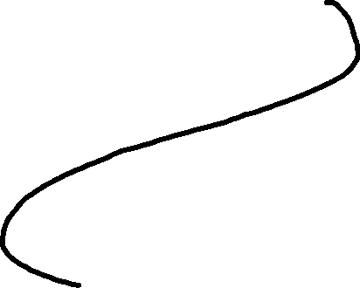
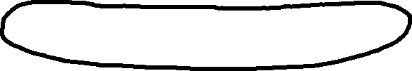
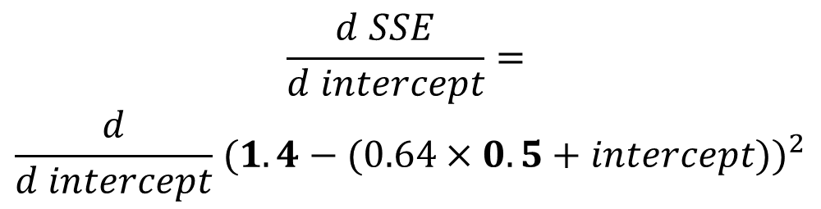
$$SSE{=(1.4−(0.64×0.5+intercept))}^{2}$$
$+ {(1.9 −(0.64×2.3+intercept))}^{2}$ $+ {(3.2 −(0.64×2.9+intercept))}^{2}$
The derivative of SSE with respect to the intercept is equal to the derivative of the first part
$$\frac{d SSE}{d intercept}=$$
$$\frac{d}{d intercept}{ (1.4−(0.64×0.5+intercept))}^{2}$$

Slide 58
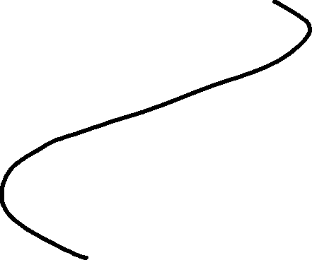
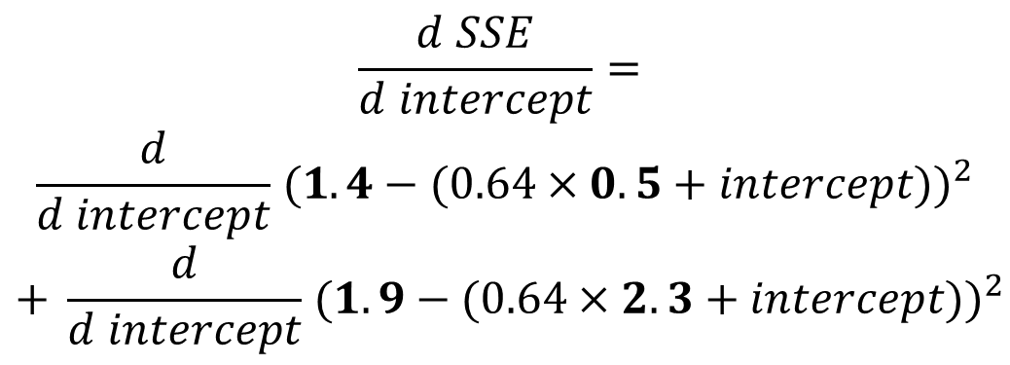
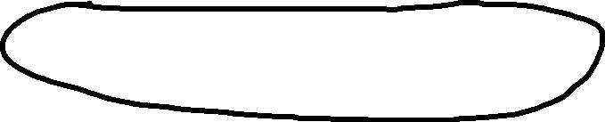
$$SSE{=(1.4−(0.64×0.5+intercept))}^{2}$$
$+ {(1.9 −(0.64×2.3+intercept))}^{2}$ $+ {(3.2 −(0.64×2.9+intercept))}^{2}$
Plus the derivative of the second part
$$\frac{d SSE}{d intercept}=$$
$$\frac{d}{d intercept}{ (1.4−(0.64×0.5+intercept))}^{2}$$
$$+ \frac{d}{d intercept}{ (1.9−(0.64×2.3+intercept))}^{2}$$

Slide 59
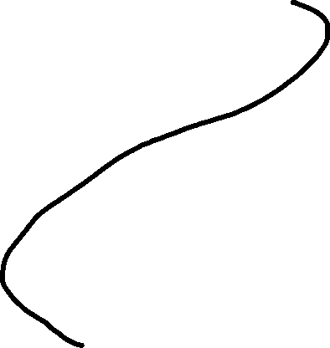
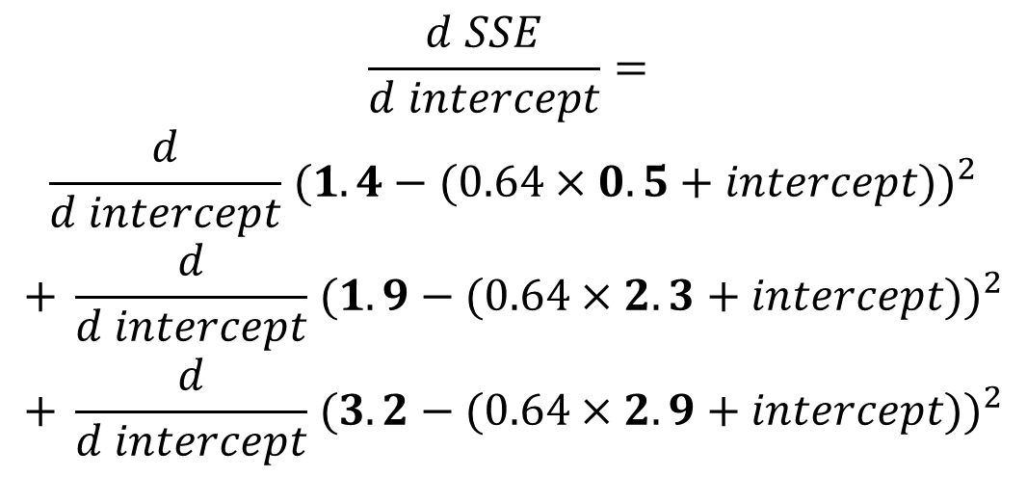
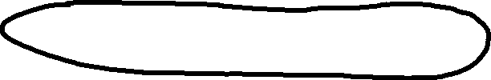
$$SSE{=(1.4−(0.64×0.5+intercept))}^{2}$$
$+ {(1.9 −(0.64×2.3+intercept))}^{2}$ $+ {(3.2 −(0.64×2.9+intercept))}^{2}$
Plus the derivative of the third part
$$\frac{d SSE}{d intercept}=$$
$$\frac{d}{d intercept}{ (1.4−(0.64×0.5+intercept))}^{2}$$
$$+ \frac{d}{d intercept}{ (1.9−(0.64×2.3+intercept))}^{2}$$
$$+ \frac{d}{d intercept}{ (3.2−(0.64×2.9+intercept))}^{2}$$

Slide 60



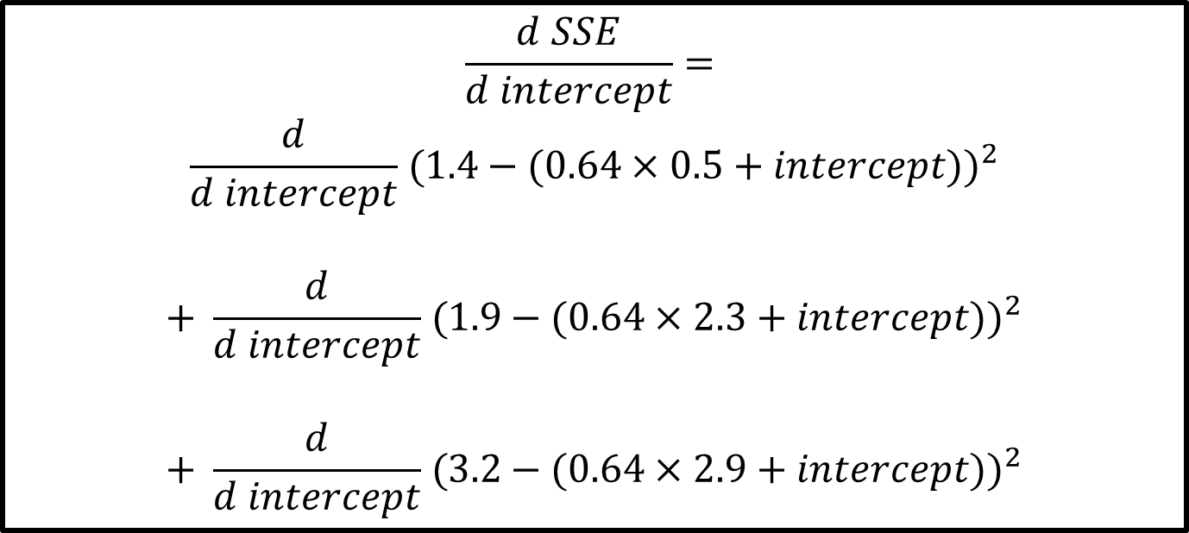
$$\frac{d SSE}{d intercept}=$$
$$\frac{d}{d intercept}{ (1.4−(0.64×0.5+intercept))}^{2}$$
$$+ \frac{d}{d intercept}{ (1.9−(0.64×2.3+intercept))}^{2}$$
$$+ \frac{d}{d intercept}{ (3.2−(0.64×2.9+intercept))}^{2}$$
We have to get the derivatives of these three expressions in order to get the derivative of SSE with respect to the intercept.

Slide 61
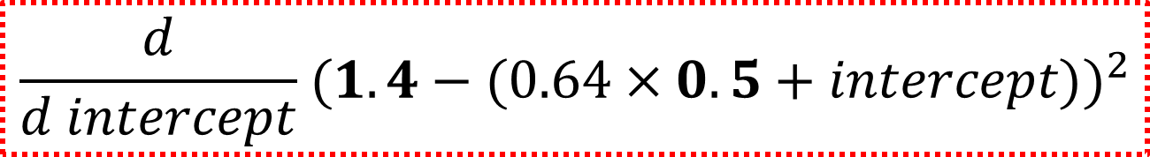
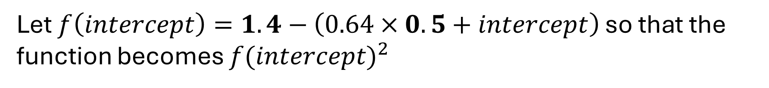
We can apply the chain rule and power rule to get the derivative of expression
$$\frac{d}{d intercept}{ (1.4−(0.64×0.5+intercept))}^{2}$$
Let $f\left(intercept\right)=1.4−\left(0.64×0.5+intercept\right)$ so that the function becomes $f{(intercept)}^{2}$

Slide 62
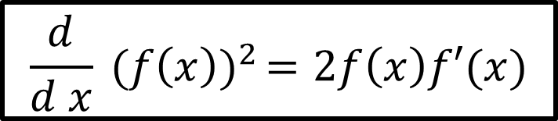
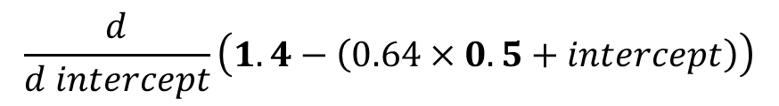
$$\frac{d}{d x}{ (f\left(x\right))}^{2}=2f\left(x\right)f′(x)$$
We can then use the derivative formula,
To get,
$$\frac{d}{d intercept}{ (f\left(intercept\right))}^{2}=2\left(1.4−\left(intercept+0.64 ×0.5\right)\right)×\frac{d}{d intercept}(1.4−(0.64×0.5+intercept))$$
$$\frac{d}{d intercept}\left(1.4−\left(0.64×0.5+intercept\right)\right)$$
For this part,

Slide 63
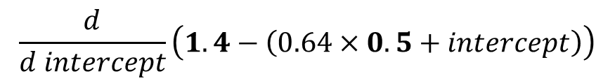
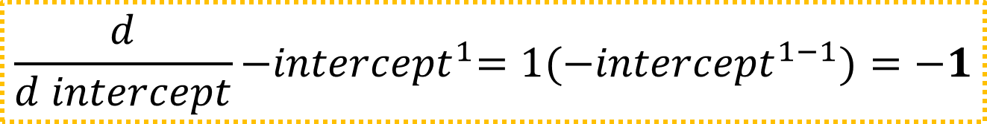
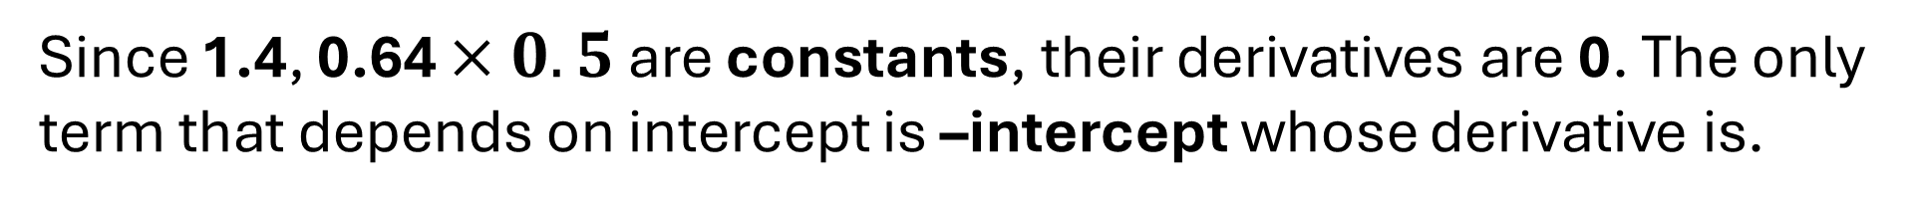
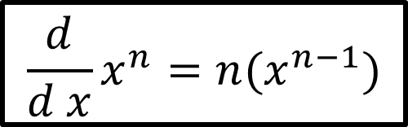
$$\frac{d}{d intercept}\left(1.4−\left(0.64×0.5+intercept\right)\right)$$
Since 1.4, 0.64 $×0.5$ are constants, their derivatives are 0. The only term that depends on intercept is –intercept whose derivative is.
$$\frac{d}{d x}x^{n}=n{(x}^{n−1})$$
$$\frac{d}{d intercept}{−intercept}^{1}={1(−intercept}^{1−1})=−1$$
Thus, we get

Slide 64
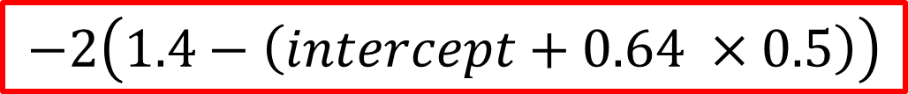
If we put -1, we get
$$\frac{d}{d intercept}{ (f\left(intercept\right))}^{2}=2\left(1.4−\left(intercept+0.64 ×0.5\right)\right)×\frac{d}{d intercept}(1.4−(0.64×0.5+intercept))$$
$$\frac{d}{d intercept}{ (f\left(intercept\right))}^{2}=2\left(1.4−\left(intercept+0.64 ×0.5\right)\right)×−1$$
Finally, when we multiply -1, we now have the derivative for expression
$$−2\left(1.4−\left(intercept+0.64 ×0.5\right)\right)$$

Slide 65
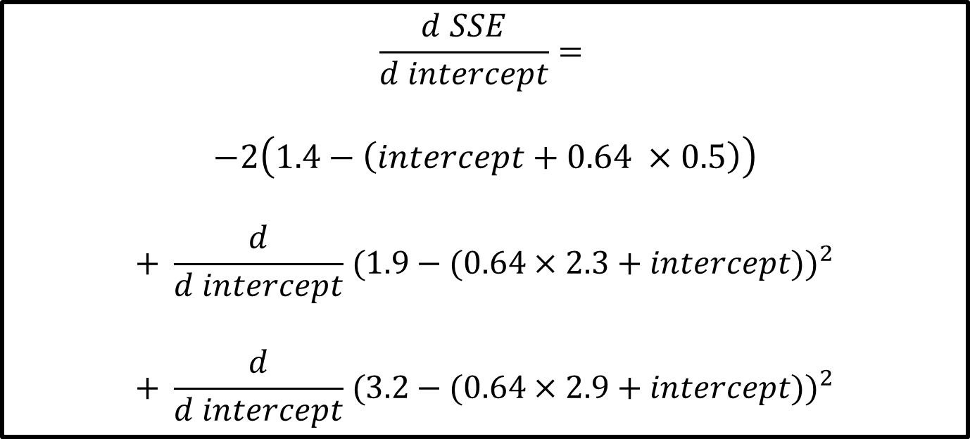
$$\frac{d SSE}{d intercept}=$$
$$−2\left(1.4−\left(intercept+0.64 ×0.5\right)\right)$$
$$+ \frac{d}{d intercept}{ (1.9−(0.64×2.3+intercept))}^{2}$$
$$+ \frac{d}{d intercept}{ (3.2−(0.64×2.9+intercept))}^{2}$$
We now have the derivative of expression
The next step is to get the derivative of expression and

Slide 66
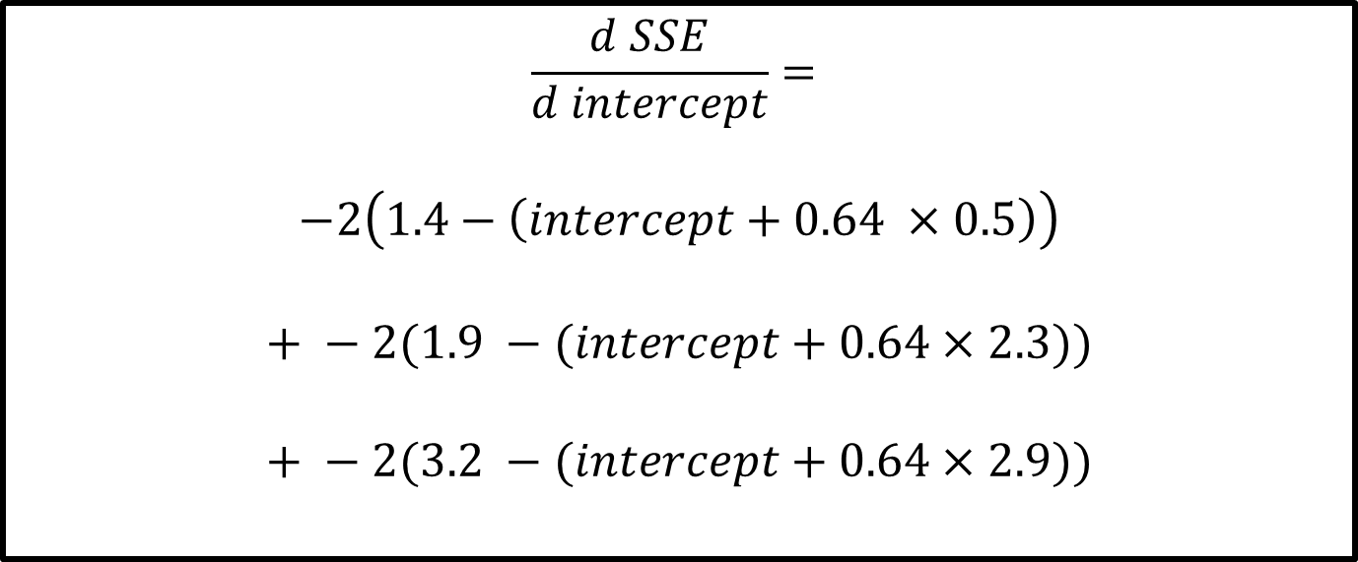
$$\frac{d SSE}{d intercept}=$$
$$−2\left(1.4−\left(intercept+0.64 ×0.5\right)\right)$$
$$+ −2(1.9 −(intercept+0.64×2.3))$$
$$+ −2(3.2 −(intercept+0.64×2.9))$$
These are the derivatives of expression and using the same process as before.

Slide 67
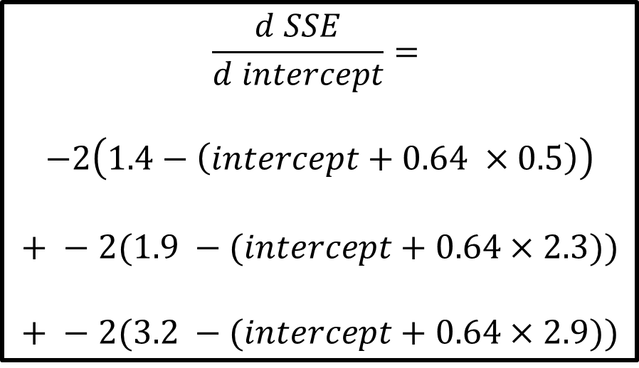
$$\frac{d SSE}{d intercept}=$$
$$−2\left(1.4−\left(intercept+0.64 ×0.5\right)\right)$$
$$+ −2(1.9 −(intercept+0.64×2.3))$$
$$+ −2(3.2 −(intercept+0.64×2.9))$$
SSE
Intercept
Now we have the derivative, Gradient Descent will use it to find where the SSE is lowest

Slide 68


$$\frac{d SSE}{d intercept}=$$
$$−2\left(1.4−\left(intercept+0.64 ×0.5\right)\right)$$
$$+ −2(1.9 −(intercept+0.64×2.3))$$
$$+ −2(3.2 −(intercept+0.64×2.9))$$
SSE
Intercept
Gradient Descent finds the minimum value by taking steps from an initial guess (random number) until it reaches the best value.

Slide 69

$$\frac{d SSE}{d intercept}=$$
$$−2\left(1.4−\left(intercept+0.64 ×0.5\right)\right)$$
$$+ −2(1.9 −(intercept+0.64×2.3))$$
$$+ −2(3.2 −(intercept+0.64×2.9))$$
SSE
Intercept
Remember, we started by setting the Intercept to a random number, in this case, we used 0.

Slide 70
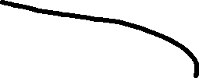
$$\frac{d SSE}{d intercept}=$$
$$−2\left(1.4−\left(intercept+0.64 ×0.5\right)\right)$$
$$+ −2(1.9 −(intercept+0.64×2.3))$$
$$+ −2(3.2 −(intercept+0.64×2.9))$$
SSE
Intercept
So we plug in 0 to the derivative

Slide 71
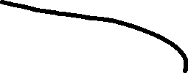
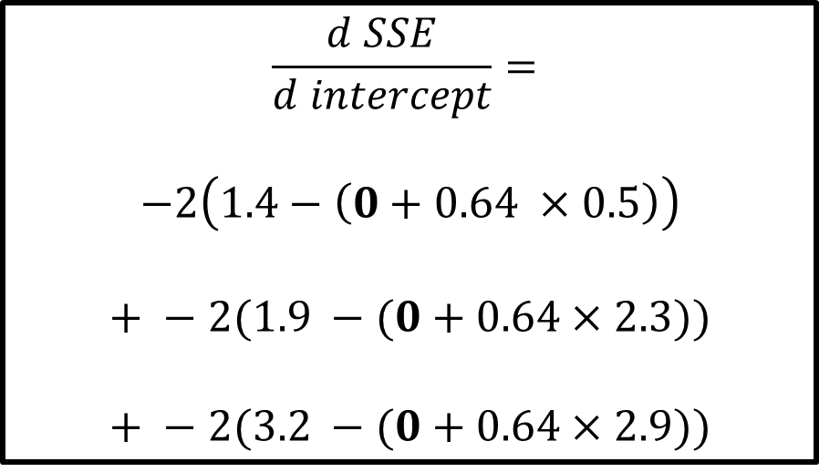
$$\frac{d SSE}{d intercept}=$$
$$−2\left(1.4−\left(0+0.64 ×0.5\right)\right)$$
$$+ −2(1.9 −(0+0.64×2.3))$$
$$+ −2(3.2 −(0+0.64×2.9))$$
SSE
Intercept
So we plug in 0 to the derivative

Slide 72
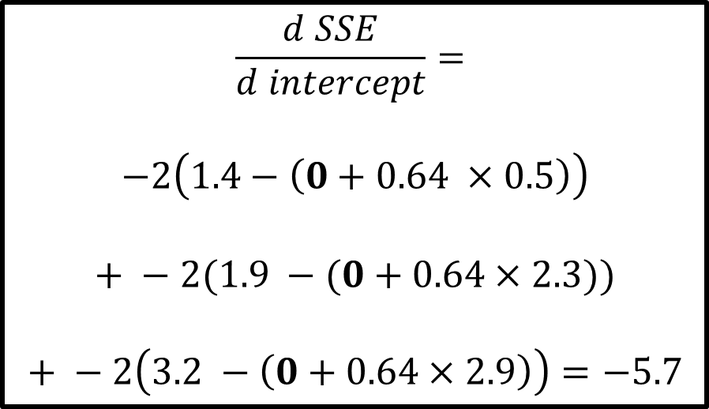
$$\frac{d SSE}{d intercept}=$$
$$−2\left(1.4−\left(0+0.64 ×0.5\right)\right)$$
$$+ −2(1.9 −(0+0.64×2.3))$$
$$+ −2\left(3.2 −\left(0+0.64×2.9\right)\right)=−5.7$$
SSE
Intercept
We get 5.7

Slide 73
$$\frac{d SSE}{d intercept}=$$
$$−2\left(1.4−\left(0+0.64 ×0.5\right)\right)$$
$$+ −2(1.9 −(0+0.64×2.3))$$
$$+ −2\left(3.2 −\left(0+0.64×2.9\right)\right)=−5.7$$
SSE
Intercept
So when the Intercept is 0, the slope of the curve is -5.7

Slide 74
$$\frac{d SSE}{d intercept}=$$
$$−2\left(1.4−\left(0+0.64 ×0.5\right)\right)$$
$$+ −2(1.9 −(0+0.64×2.3))$$
$$+ −2\left(3.2 −\left(0+0.64×2.9\right)\right)=−5.7$$
SSE
Intercept
The closer we get to the optimal value for the Intercept, the closer the slope of the curve gets to 0.

Slide 75
$$\frac{d SSE}{d intercept}=$$
$$−2\left(1.4−\left(0+0.64 ×0.5\right)\right)$$
$$+ −2(1.9 −(0+0.64×2.3))$$
$$+ −2\left(3.2 −\left(0+0.64×2.9\right)\right)=−5.7$$
SSE
Intercept
The closer we get to the optimal value for the Intercept, the closer the slope of the curve gets to 0.

Slide 76
$$\frac{d SSE}{d intercept}=$$
$$−2\left(1.4−\left(0+0.64 ×0.5\right)\right)$$
$$+ −2(1.9 −(0+0.64×2.3))$$
$$+ −2\left(3.2 −\left(0+0.64×2.9\right)\right)=−5.7$$
SSE
Intercept
The closer we get to the optimal value for the Intercept, the closer the slope of the curve gets to 0.

Slide 77
$$\frac{d SSE}{d intercept}=$$
$$−2\left(1.4−\left(0+0.64 ×0.5\right)\right)$$
$$+ −2(1.9 −(0+0.64×2.3))$$
$$+ −2\left(3.2 −\left(0+0.64×2.9\right)\right)=−5.7$$
SSE
Intercept
And when the slope of the curve gets closer to 0, we should take small steps because we are close to the optimal value.

Slide 78
$$\frac{d SSE}{d intercept}=$$
$$−2\left(1.4−\left(0+0.64 ×0.5\right)\right)$$
$$+ −2(1.9 −(0+0.64×2.3))$$
$$+ −2\left(3.2 −\left(0+0.64×2.9\right)\right)=−5.7$$
SSE
Intercept
And when the slope of the curve gets closer to 0, we should take small steps because we are close to the optimal value.

Slide 79
$$\frac{d SSE}{d intercept}=$$
$$−2\left(1.4−\left(0+0.64 ×0.5\right)\right)$$
$$+ −2(1.9 −(0+0.64×2.3))$$
$$+ −2\left(3.2 −\left(0+0.64×2.9\right)\right)=−5.7$$
SSE
Intercept
And when the slope is far from 0, then we should take big steps because we are far from the optimal value.

Slide 80
$$\frac{d SSE}{d intercept}=$$
$$−2\left(1.4−\left(0+0.64 ×0.5\right)\right)$$
$$+ −2(1.9 −(0+0.64×2.3))$$
$$+ −2\left(3.2 −\left(0+0.64×2.9\right)\right)=−5.7$$
SSE
Intercept
And when the slope is far from 0, then we should take big steps because we are far from the optimal value.

Slide 81
$$\frac{d SSE}{d intercept}=$$
$$−2\left(1.4−\left(0+0.64 ×0.5\right)\right)$$
$$+ −2(1.9 −(0+0.64×2.3))$$
$$+ −2\left(3.2 −\left(0+0.64×2.9\right)\right)=−5.7$$
SSE
Intercept
And when the slope is far from 0, then we should take big steps because we are far from the optimal value.

Slide 82
$$\frac{d SSE}{d intercept}=$$
$$−2\left(1.4−\left(0+0.64 ×0.5\right)\right)$$
$$+ −2(1.9 −(0+0.64×2.3))$$
$$+ −2\left(3.2 −\left(0+0.64×2.9\right)\right)=−5.7$$
SSE
Intercept
If we take a very big step, the SSE would increase

Slide 83
$$\frac{d SSE}{d intercept}=$$
$$−2\left(1.4−\left(0+0.64 ×0.5\right)\right)$$
$$+ −2(1.9 −(0+0.64×2.3))$$
$$+ −2\left(3.2 −\left(0+0.64×2.9\right)\right)=−5.7$$
SSE
Intercept
The size of the step should be related to the slope since it tells us if we should take a small step or a big step and to make sure that we will move beyond the optimal value by taking a very big step.

Slide 84

$$\frac{d SSE}{d intercept}=$$
$$−2\left(1.4−\left(0+0.64 ×0.5\right)\right)$$
$$+ −2(1.9 −(0+0.64×2.3))$$
$$+ −2\left(3.2 −\left(0+0.64×2.9\right)\right)=−5.7$$
SSE
Intercept
Gradient Descent determines the Step size by multiplying the slope by a small number called the Learning Rate.
$$Step Size=−5.7 ×0.1$$

Slide 85
$$\frac{d SSE}{d intercept}=$$
$$−2\left(1.4−\left(0+0.64 ×0.5\right)\right)$$
$$+ −2(1.9 −(0+0.64×2.3))$$
$$+ −2\left(3.2 −\left(0+0.64×2.9\right)\right)=−5.7$$
SSE
Intercept
With the Step Size, we can calculate a New Intercept
$$Step Size=−5.7 ×0.1$$

Slide 86

$$\frac{d SSE}{d intercept}=$$
$$−2\left(1.4−\left(0+0.64 ×0.5\right)\right)$$
$$+ −2(1.9 −(0+0.64×2.3))$$
$$+ −2\left(3.2 −\left(0+0.64×2.9\right)\right)=−5.7$$
SSE
Intercept
The New Intercept is the old intercept minus the Step Size
$$Step Size=−5.7 ×0.1$$
$$New Intercept=Old Intercept−Step Size$$

Slide 87

$$\frac{d SSE}{d intercept}=$$
$$−2\left(1.4−\left(0+0.64 ×0.5\right)\right)$$
$$+ −2(1.9 −(0+0.64×2.3))$$
$$+ −2\left(3.2 −\left(0+0.64×2.9\right)\right)=−5.7$$
SSE
Intercept
Let us plug in the numbers..
$$Step Size=−5.7 ×0.1=0.57$$
$$New Intercept=0−\left(−.57\right)=0.57$$

Slide 88
$$\frac{d SSE}{d intercept}=$$
$$−2\left(1.4−\left(0+0.64 ×0.5\right)\right)$$
$$+ −2(1.9 −(0+0.64×2.3))$$
$$+ −2\left(3.2 −\left(0+0.64×2.9\right)\right)=−5.7$$
SSE
Intercept
And the New Intercept is 0.57
$$Step Size=−5.7 ×0.1=0.57$$
$$New Intercept=0−\left(−.57\right)=0.57$$

Slide 89
$$\frac{d SSE}{d intercept}=$$
$$−2\left(1.4−\left(0+0.64 ×0.5\right)\right)$$
$$+ −2(1.9 −(0+0.64×2.3))$$
$$+ −2\left(3.2 −\left(0+0.64×2.9\right)\right)=−5.7$$
SSE
Intercept
With one big step, we moved much closer to the optimal value for the Intercept

Slide 90
$$\frac{d SSE}{d intercept}=$$
$$−2\left(1.4−\left(0+0.64 ×0.5\right)\right)$$
$$+ −2(1.9 −(0+0.64×2.3))$$
$$+ −2\left(3.2 −\left(0+0.64×2.9\right)\right)=−5.7$$
SSE
Intercept
Now let us take another step closer to the optimal value for the Intercept

Slide 91
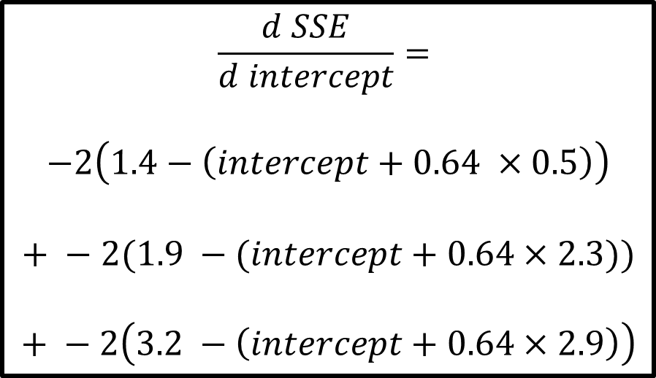
$$\frac{d SSE}{d intercept}=$$
$$−2\left(1.4−\left(intercept+0.64 ×0.5\right)\right)$$
$$+ −2(1.9 −(intercept+0.64×2.3))$$
$$+ −2\left(3.2 −\left(intercept+0.64×2.9\right)\right)$$
SSE
Intercept
To take another step, we go back to the derivative and plug in in the New Intercept (0.57)

Slide 92
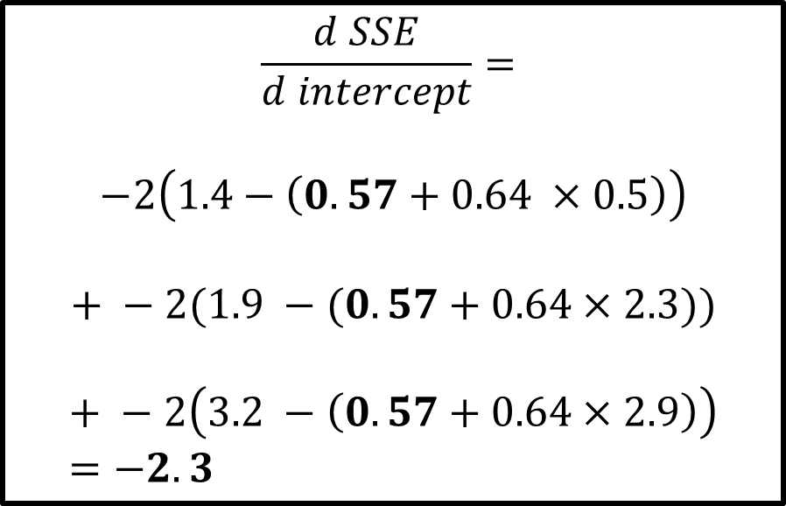
$$\frac{d SSE}{d intercept}=$$
$$−2\left(1.4−\left(0.57+0.64 ×0.5\right)\right)$$
$$+ −2(1.9 −(0.57+0.64×2.3))$$
$$+ −2\left(3.2 −\left(0.57+0.64×2.9\right)\right)=−2.3$$
SSE
Intercept
And that tells us that the slope of the curve is -2.3

Slide 93
$$\frac{d SSE}{d intercept}=$$
$$−2\left(1.4−\left(0.57+0.64 ×0.5\right)\right)$$
$$+ −2(1.9 −(0.57+0.64×2.3))$$
$$+ −2\left(3.2 −\left(0.57+0.64×2.9\right)\right)=−2.3$$
SSE
Intercept
Let us calculate the Step Size and we get
$$Step Size=−2.3 ×0.1=−0.23$$

Slide 94
$$\frac{d SSE}{d intercept}=$$
$$−2\left(1.4−\left(0.57+0.64 ×0.5\right)\right)$$
$$+ −2(1.9 −(0.57+0.64×2.3))$$
$$+ −2\left(3.2 −\left(0.57+0.64×2.9\right)\right)=−2.3$$
SSE
Intercept
Giving us a New Intercept of 0.8
$$Step Size=−2.3 ×0.1=−0.23$$
$$New Intercept=0.57−\left(−0.23\right)=0.8$$

Slide 95
$$\frac{d SSE}{d intercept}=$$
$$−2\left(1.4−\left(0.57+0.64 ×0.5\right)\right)$$
$$+ −2(1.9 −(0.57+0.64×2.3))$$
$$+ −2\left(3.2 −\left(0.57+0.64×2.9\right)\right)=−2.3$$
SSE
Intercept
Notice that the first step was relatively large compared to the second step.

Slide 96
SSE
Intercept
Then we take another step and the New Intercept is 0.8

Slide 97
SSE
Intercept
Then we take another step and the New Intercept is 0.92

Slide 98
SSE
Intercept
Then we take another step and the New Intercept is 0.94

Slide 99
SSE
Intercept
Then we take another step and the New Intercept is 0.95

Slide 100
SSE
Intercept
Notice how each step gets smaller and smaller the closer we get to the bottom of the curve.

Slide 101
SSE
Intercept
After 6 steps, the Gradient Descent estimate for the Intercept is 0.95

Slide 102
SSE
Intercept
So now we know how Gradient Descent finds the optimal value, but how does it know when to stop?

Slide 103
SSE
Intercept
Gradient Descent stops when the Step Size is very close to 0
$$Step Size=Slope ×Learning Rate$$

Slide 104
SSE
Intercept
The Step Size will be very close to 0 when the Slope is very close to 0
$$Step Size=Slope ×Learning Rate$$

Slide 105
SSE
Intercept
In practice, the minimum Step Size is 0.001 or smaller
$$Step Size=Slope ×Learning Rate$$

Slide 106
SSE
Intercept
So if it becomes smaller than 0.001, Gradient Descent would stop
$$Step Size=Slope ×Learning Rate$$

Slide 107
SSE
Intercept
We can also set a limit on the number of steps it will take, In practice, the Maximum Number of Steps is 1000 or greater

